Slide 1
CHAPTER TWO
THEORY OF DEMAND & SUPPLY AND ELASTICITY

Slide 2
Demand
Quantity Demanded – the amount(number) of a good that a consumer is willing and able to purchase at the given price in a given period of time.
Demand –consumers willingness and ability to purchase goods and services at various prices in a specific period of time., holding all else constant.

Slide 3
Cont…
The relationship between price and quantity demanded can be seen using demand schedule, demand curve, demand function.
Demand Schedule – a table that shows the relationship between quantity demanded and price ,ceteris paribus
Demand Curve – a graph that shows the relationship between quantity demanded and price ,ceteris paribus
Demand Function – a mathematical expression that shows the relationship between quantity demanded and price, ceteris paribus
Law of Demand – All else equal, as price falls the quantity demanded rises and vice versa.

Slide 4
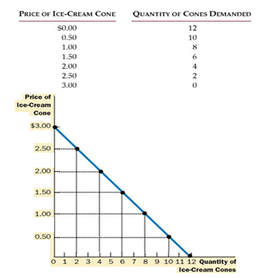
Cont…

Slide 5
Market Demand Versus Individual Demand Curve
Individual Demand Curve – is a curve that represents the price quantity combination of a particular good for a single buyer
Market Demand Curve – is a curve that represents the price quantity combination of a particular good for all buyer

Slide 6
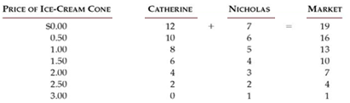
Cont…
Individual and market demand schedule

Slide 7
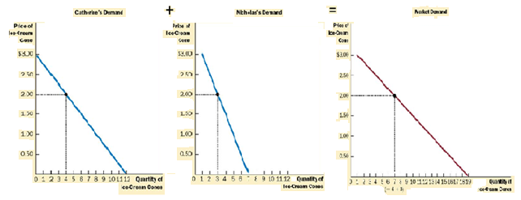
Cont…
Individual and market demand curve
Exercise: If there are 1000 identical buyers in the market, each with a demand function of Qdx=8-Px, then what is the market demand function?

Slide 8
Determinants of Demand
Price of product itself
Income
3. Price of Related Goods
a. Substitute Goods
b. Complementary Goods
4. Tastes and Preferences
5. Expectations
6. Number of buyers

Slide 9
Changes in Quantity Demand vs. Changes in Demand
Changes in Quantity Demand –is represented by a movement a long a given demand curve
=>This is caused by the change in the price of the good
Changes in Demand–is represented by a shift of the demand curve
=>This is caused by the change in the determinants of demand other than price of the product

Slide 10
Cont…
1. Income
Normal Good – the higher your income the more you consume
Examples: Sports Tickets, Cars, and Luxury Goods
↑Income
=> consume more at each P
=>↑D
Inferior Good – as income rises you consume less
Examples: Shiro wot, Cabbage
↑Income
=> consume other products
=> ↓ D

Slide 11
Cont…
2. Price of Related Goods
Substitute Goods – two goods in which a consumer will consume one good or the other
Examples: Pepsi or Coke, Rent Movie or Go to Theater
↑Price of Pepsi
=> drink less Pepsi
=> purchase more Coke
=> ↑D

Slide 12
Cont…
Complementary Goods – two goods consumed together
Examples: gasoil and car, DVD Player and Movie, sugar and tea
↑Price of sugar
=> consume less tea
=> consume less sugar and tea
=> ↓D

Slide 13
Cont…
3. Tastes / Preference
New tastes for the product
=> Consume more
=> ↑D
4. Expectations
↑Price tomorrow
=> buy today instead of tomorrow
=> ↑D
5. Number of buyers
↑number of buyers
=> More of the good is consumed
=> ↑D

Slide 14
Supply
Quantity Supplied – the amount(number) of a good that a producer is willing and able to offer at each price level in a given period of time.
Supply –producers willingness and ability to provide goods and services at different prices in a specific period of time., holding all else constant.

Slide 15
Cont…
The relationship between price and quantity supplied can be seen using supply schedule, supply curve, supply function.
Supply Schedule – a table that shows the relationship between quantity supplied and price ,ceteris paribus
Supply Curve – a graph that shows the relationship between quantity supplied and price ,ceteris paribus
Supply Function – a mathematical expression that shows the relationship between quantity supplied and price,ceteris paribus
Law of Supply – All else equal, as price falls the quantity supplies falls and vice versa

Slide 16
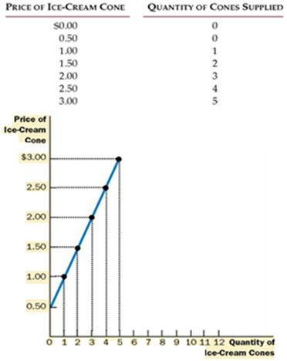
Cont…
Supply schedule and curve

Slide 17
Market Supply Versus Individual Supply Curve
Individual Supply Curve – is a curve that represents the price quantity combination of a particular good for a single seller
Market Supply Curve – is a curve that represents the price quantity combination of a particular good for all sellers

Slide 18
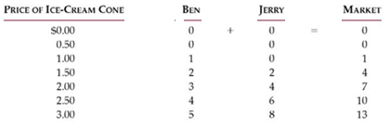
Cont…
Individual and market supply schedule

Slide 19
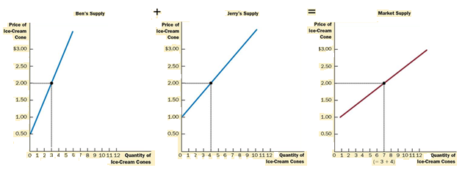
Cont…
Individual and market supply curve

Slide 20
Changes in Quantity Supply vs. Changes in Supply
Changes in Quantity Supply –is represented by a movement a long a given Supply curve
=>This is caused by the change in the price of the good
Changes in Supply–is represented by a shift of the Supply curve
=>This is caused by the change in the determinants of Supply other than price of the product

Slide 21
Determinants of Supply
1. Price of the product itself
2. Cost of Production
a. Prices of required inputs
b. Technologies used in production
2. Price of Related Products
3. Taxes and Subsidies
4. Sellers Expectation
5. Number of sellers
6. Weather condition

Slide 22
Cont…
1. Cost of Production
a. Prices of required inputs
↑Price of labor
=>hire less people
=>produce less at current P
=>↓S
b. Technologies used in production
New technology
=> produce output for less
=> higher profit on output
=> produce more at current P
=> ↑S

Slide 23
Cont…
2. Price of Related Products
Examples: wheat Vs teff, leather Jacket Vs leather shoe
↑Price of leather Jacket
=> produce less leather shoe
=> Produce more leather Jacket
=> ↓S of leather shoe
3. Number of sellers
↑number of sellers
=> More of the good is produced
=> ↑S
4. Expectations
↑Price tomorrow
=> Sell tomorrow instead of today
=> ↓S

Slide 24
Cont…
5. Taxes and subsidies
↑ tax
=> Less of the good is produced
=> ↓S
↑subsidy
=> more of the good is produced
↑S
6. Weather condition(Agricultural Products)
Good Vs bad weather condition
Good Weather condition
=> ↑ production of the good
=> ↑S

Slide 25
Market Equilibrium
Market Equilibrium – occurs at a point at which the supply and demand curves intersect.
=> occurs when there is no incentive for prices to change (a steady state).
This occurs when QS = QD
The price at which these two curves cross is called the equilibrium price
The quantity at which these two curves cross is called the equilibrium quantity

Slide 26
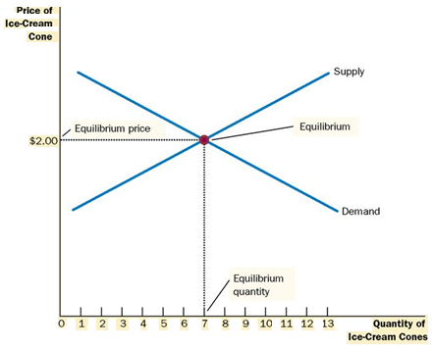
Cont…
Market equilibrium

Slide 27
Cont…
Exercise 1: From statistical studies, we know that for 1981 the supply curve for wheat was approximately as follows:
Supply: Q_{S} = 1800 + 240P
Where price is measured in dollars per bushel and quantities are in millions of bushels per year. These studies also indicate that in 1981 the demand curve for wheat was
Demand: Q_{D} = 3550 – 266P
Find the market clearing price and equilibrium quantity of wheat for the year1981.

Slide 28
Cont…
Shortage (Excess Demand) – a shortage occurs when the quantity demanded is greater than the quantity supplied at a particular price.
Surplus (Excess Supply) – a surplus occurs when the quantity demanded is less than the quantity supplied at a particular price.

Slide 29
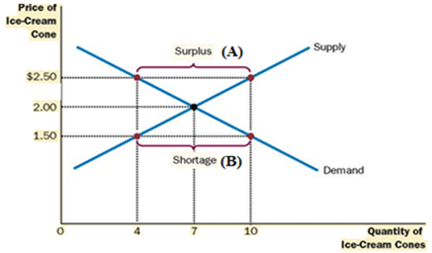
Cont…
Figure for shortage and surplus

Slide 30
Effects of changes in demand and supply in equilibrium price and equilibrium quantity
Events that affect demand or supply (or both) will alter the equilibrium price and quantity. Let’s see for the following conditions;
a. Change in demand keeping supply constant
b. Change in supply keeping demand constant
c. Simultaneous change in demand and supply

Slide 31
a. Change in demand keeping supply constant I. when demand increases
Demand curve shifts to the right
Equilibrium point changes
Equilibrium price and quantity increases
p Do D1 So
F
P1
E
P0
Q

Slide 32
II. when demand decreases
Demand curve shifts to the left
Equilibrium point changes
Equilibrium price and quantity decreases
p D1 Do So
E
P0
F
P1
Q

Slide 33
b. Change in supply keeping demand constant I. when supply increases
Supply curve shifts to the right/outward
Equilibrium price decreases but quantity increases
So
P S1
E
P0
P1 F
D0
Q0 Q1 Q

Slide 34
II. when supply decreases
Supply curve shifts to the left/inward
Equilibrium price increases but quantity decreases
S1
P S0
B
P1
P0 A
D0
Q1 Q0 Q

Slide 35
c. Change in both demand and supply
When demand increases and supply decreases
When DD↑ ↑P* and Q* ↑
When SS ↓ ↑P* and Q* ↓
___________________________
P* ,but Q* remains indeterminate

Slide 36
Cont…
II. When demand decreases and supply increases
When DD ↓ ↑P* and Q* ↓
When SS↑ ↓ P* and Q* ↑
___________________________
P* ,but Q* remains indeterminate

Slide 37
Cont…
III. When both demand and supply increase
When DD ↑ ↑P* and Q* ↑
When SS↑ ↓ P* and Q* ↑
___________________________
P* remains indeterminate, Q*
IV. When both demand and supply decrease
When DD ↓ ↓ P* and Q* ↓
When SS ↓ ↑ P* and Q* ↓
___________________________
P* remains indeterminate, Q*

Slide 38
Elasticity Of Demand and Supply
Elasticity refers to responsiveness
Price Elasticity of Demand - measures how responsive consumers react to price change
Price elasticity of demand = Percentage change in quantity demanded Percentage change in price
ED = %ΔQ
%ΔP
Point price elasticity of demand
ED = ΔQ . P
ΔP Q
Arc price elasticity of demand
ED = ΔQ . P+P’
ΔP Q+Q’

Slide 39
Cont…
Elasticity expresses a relationship
between two amounts
=> The percent change in quantity demanded
=> The percent change in price
The law of demand states that price and
quantity demanded are inversely related,
=> the change in price and the change in
quantity demanded have opposite signs
=> the price elasticity of demand has a negative sign
Referring a negative number gets
cumbersome, the price elasticity of
demand is represented as an absolute value => positive number

Slide 40
Categories of Elasticity of Demand
1. Inelastic:
Elasticity is between 0 and 1.0
The percent change in quantity demanded is
smaller than the percent change in price,
Quantity demanded is relatively unresponsive to a change in price
2.unit-elastic :
elasticity with an absolute value of 1.0
If the percent change in quantity demanded equals the percent change in price

Slide 41
Cont…
3.Elastic:
price elasticity has an absolute value exceeding 1.0
The percent change in quantity
demanded exceeds the percent change in price
4. Perfectly inelastic
demand curve is vertical
regardless of the price, the quantity demanded stays the same
price elasticity of demand approaches zero
5. Perfectly elastic demand
price elasticity of demand approaches infinity
the demand curve becomes horizontal
reflecting the fact that very small changes in the price lead to
huge changes in the quantity demanded

Slide 42
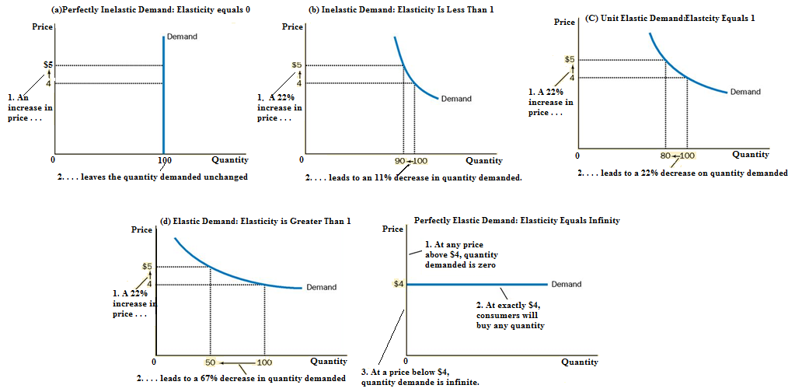

Slide 43
Elasticity and Total Revenue
Price elasticity can indicate the effect of a price change on total revenue
Total revenue (TR) is the price (p) multiplied by the quantity demanded (q) at that price
TR = p x q

Slide 44
Cont…
Relation between Elasticity and Total Revenue
When demand is elastic,
percent increase in quantity demanded≧ percent decrease in price
Total revenue increases
When demand is unit elastic,
percent increase in quantity demanded= percent decrease in price
Total revenue remains unchanged
When demand is inelastic,
percent increase in quantity demanded ≦the percent decrease in price
Total revenue decreases

Slide 45
Cont…
2. Income Elasticity of Demand
Measures the percent change in demand divided by the percent change in income
EI = ΔQ . I
ΔI Q
Categories of Income Elasticity of Demand
Goods with income elasticity less than zero are called inferior goods => demand declines when income increases
Normal goods have income elasticity greater than zero => demand increases when income increases
Normal goods with income elasticity greater than zero but less than 1 are called income inelastic goods(necessary goods) => demand increases not as much as income does
Goods with income elasticity greater than 1 are called income elastic(luxury goods) => demand increases more than does income does

Slide 46
Cont…
3. Cross price elasticity of demand
Measures the percent change in demand of a good divided by the percent change in price of an other good.
EX = ΔQX . PY
ΔPY QX
Categories of cross price Elasticity of Demand
Goods with cross price elasticity less than zero are called complementary goods=> demand of a good declines when price of another good increases
Goods with cross price elasticity greater than zero are called subistute goods=> demand of a good increases when price of another good increases
Goods with cross price elasticity equals to zero are called unrelated goods=> demand of a good doesn’t change when price of another good increases

Slide 47
Cont…
4. Price elasticity of supply
Measures how responsive producers are to a price change
Price elasticity of supply = Percentage change in quantity supplied
Percentage change in price
Es = %ΔQs
%ΔP
Point price elasticity of supply
Es = ΔQs . P
ΔP Qs
Arc price elasticity of supply
Es = ΔQs . P+P’
ΔP Qs+Qs’

Slide 48
Categories of Supply Elasticity
The terminology for supply elasticity is the same as for demand elasticity
If supply elasticity is less than 1.0, supply is inelastic
If it equals 1.0, supply is unit elastic
If it exceeds 1.0, supply is elastic
If it approaches to infinity, supply is Perfectly elastic
If it approaches to Zero, supply is Perfectly inelastic
Exercise 2: Plot the graphs of perfectly inelastic and perfectly elastic supply curves.
Exercise 3: Find the price elasticity of demand and supply of wheat for the year 1981 at the equilibrium price and quantity.
Exercise 4:If demand function is given by P=50-0.1Q. Find the unit elastic point

